Slide 1

FINAL PRESENTATION
PROJECT CHARTER, REQUIREMENTS AND SYSTEMS DESIGN
Devendra Reddy Konasani (1232253674), Narasimha Uday Kiran Narayana (1232310107), Raghu Menni Lokanadhanaidu (1232328671)
Dr. Derex O. Griffin

Slide 2
PROJECT CHARTER
PROBLEM STATEMENT
Manual data entry and decentralized spreadsheets hinder asset tracking scalability, increasing data inconsistency risks. Limited visibility and real-time reporting across stages impede decision-making and resource allocation, impacting strategic planning.
TECHNOLOGY SOLUTION STATEMENT
Implementing an integrated IT asset management system enhances scalability, mitigates data inconsistency risks, and enables real-time visibility for informed decision-making and organizational planning.
Narrated by Raghu

Slide 3
PROJECT BENEFITS
Reduction in manual data entry time by 50%, leading to increased efficiency in asset tracking processes.
Improved data accuracy, resulting in a 30% decrease in data inconsistency-related errors.
Enhanced decision-making capabilities with real-time reporting, reducing response time for strategic planning by 20%.
Implementation of the integrated IT asset management system is expected to yield significant time savings, reduced errors, and improved decision-making for organizational planning and efficiency.
Narrated by Raghu

Slide 4
Business Function 1
Purpose of Serial Asset Tracker and Management:
Efficiently track, manage, and distribute serialized assets within the organization.
Streamline the process of ordering, monitoring, and maintaining electronic assets like laptops, microphones, mice, thumb drives, and projectors.
Narrated by Raghu

Slide 5
Asset Tracking and Monitoring:
Centralize tracking of asset location, status, and usage history.
Enable real-time monitoring of asset availability, assignment, and movement across different locations or departments.
Asset Ordering and Allocation:
Facilitate easy ordering of electronic assets by end-users through a user-friendly interface.
Allow end-users to specify quantity, rental duration, and delivery date for each asset order.
Automate allocation process for timely fulfillment based on availability and organizational policies.
Narrated by Raghu

Slide 6
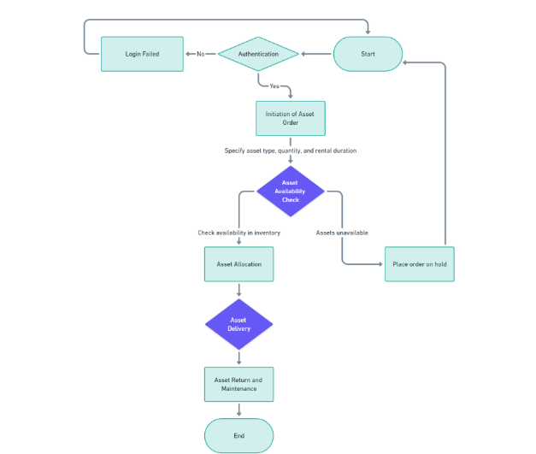
Narrated by Raghu

Slide 7
Business Function 2: Stockroom Management
Purpose:
Efficiently handle order retrieval and maintain organized inventory in warehouses.
Utilize smart inventory techniques to optimize stockroom operations and improve customer satisfaction.
Order Fulfillment:
Stockroom Custodian manages order requests through a special app, ensuring swift processing.
Locates requested items in the stockroom and maintains real-time visibility of inventory levels.
Narrated by Uday Kiran

Slide 8
Asset Assignment and Tracking:
The app facilitates asset distribution to individual users using unique codes for easy tracking.
Ensures accountability by keeping records of who has borrowed which assets.
Notification System: Sends reminders to users when assets are overdue for return, ensuring organizational efficiency.
Stockroom Identifier:
Assigns unique codes to each stockroom for effective organization and smooth operations.
Enhances data management and facilitates efficient stockroom supervision.
Narrated by Uday Kiran

Slide 9
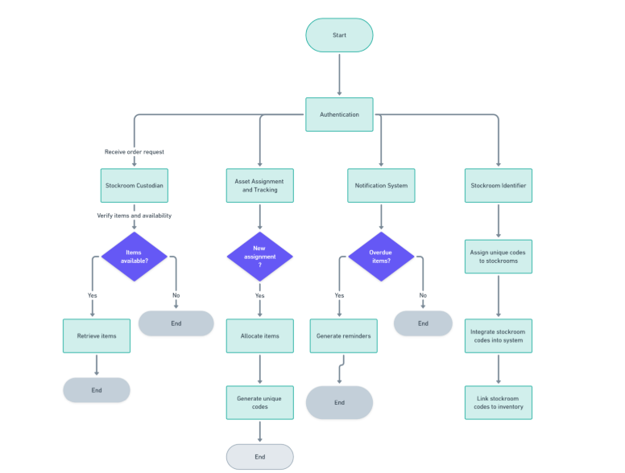
Narrated by Uday Kiran

Slide 10
System Design - GUIs:
User Interface Wireframe 1: Serial Asset Tracker (SAT)
Streamlined interface for tracking, managing, and distributing serialized electronic resources.
Core features: centralized monitoring of asset location, status, and usage history.
Easy navigation for accessing asset tracking, ordering, reports, and administrative tasks.
Dashboard offers overview of asset availability, recent orders, and movements, with quick links for common actions.
Administration capabilities include user, asset category, and location management, plus system settings customization.
Narrated by Uday Kiran

Slide 11
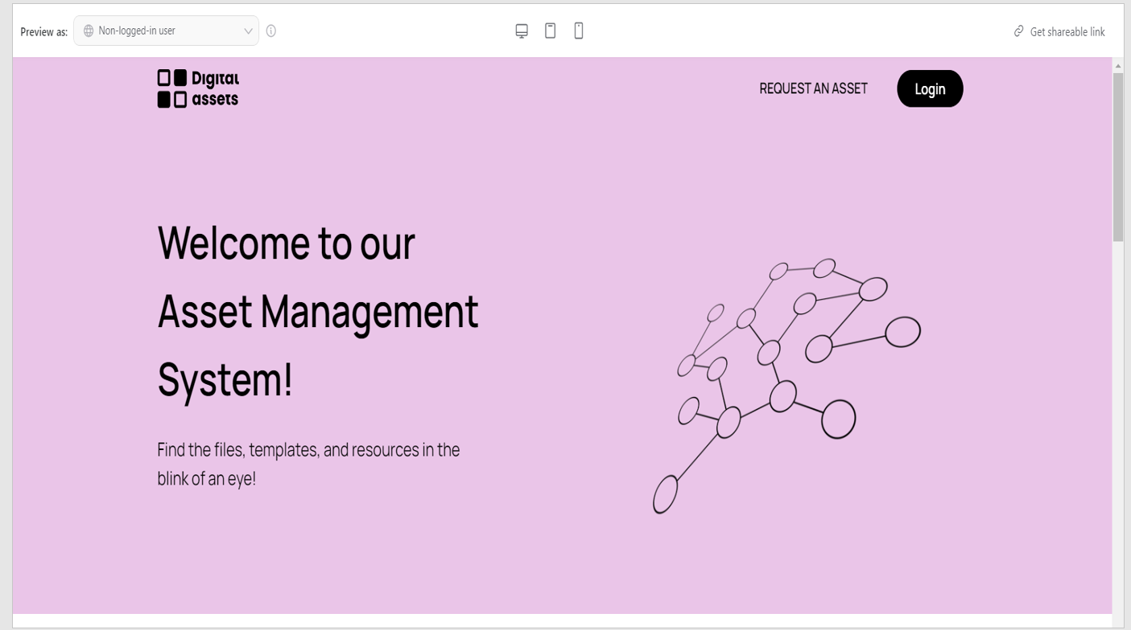
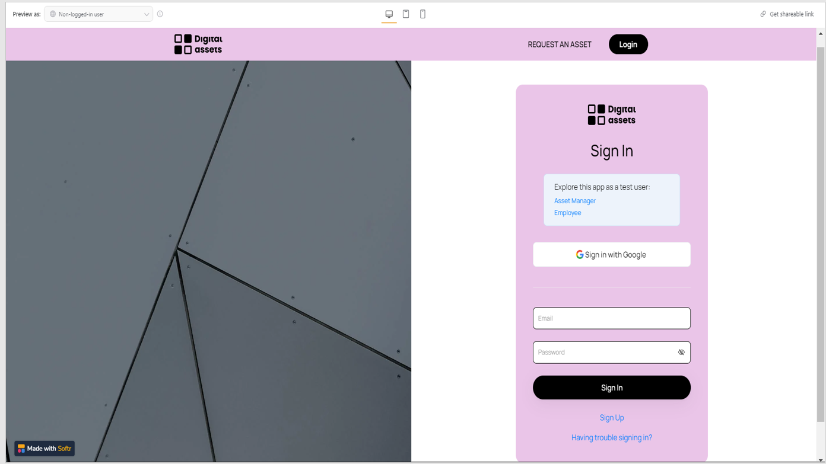
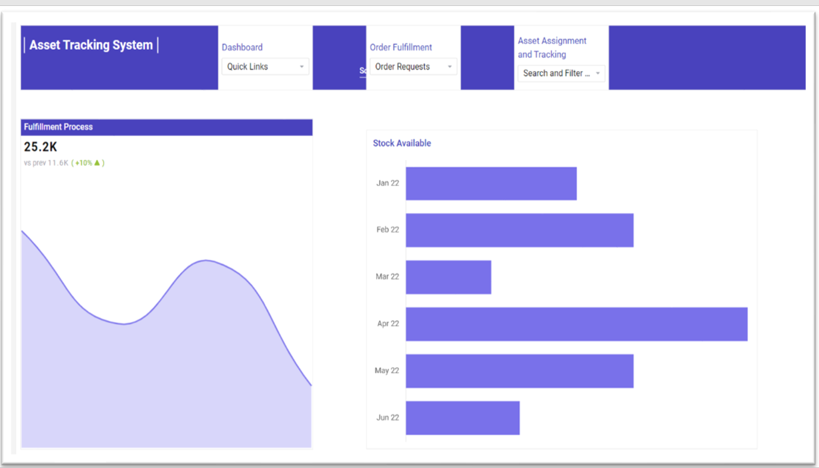
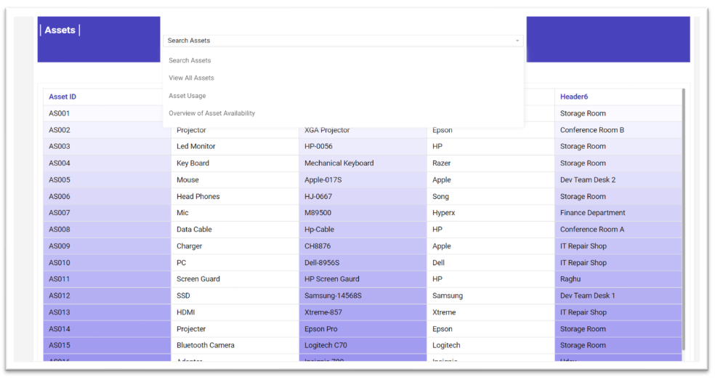
Narrated by Uday Kiran

Slide 12
User Interface Wireframe 2: The Stockroom Management System
Stockroom Management System focuses on efficient order retrieval and inventory organization.
Utilizes smart inventory techniques to enhance operational effectiveness and expedite customer deliveries.
Stockroom Custodian oversees order requests through a specialized application, ensuring real-time visibility of inventory levels.
Asset assignment and tracking facilitated by unique codes for streamlined distribution and accountability.
Integrated notification system prompts users to return items promptly, promoting organizational efficiency.
Narrated by Devendra Reddy

Slide 13
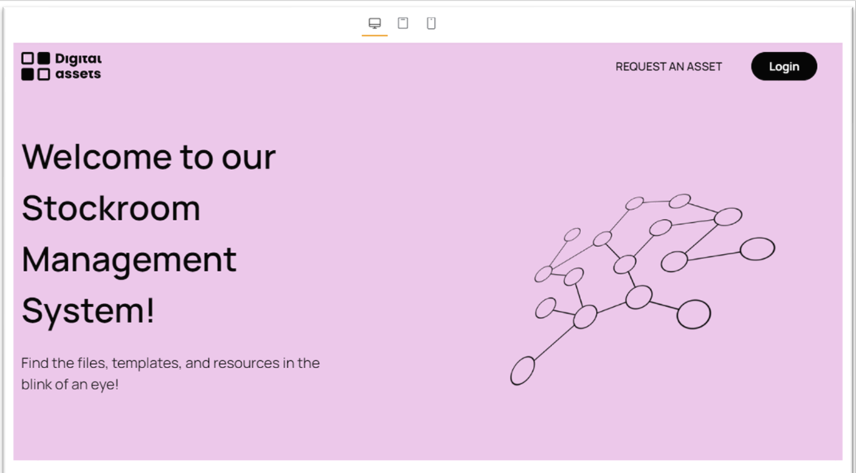
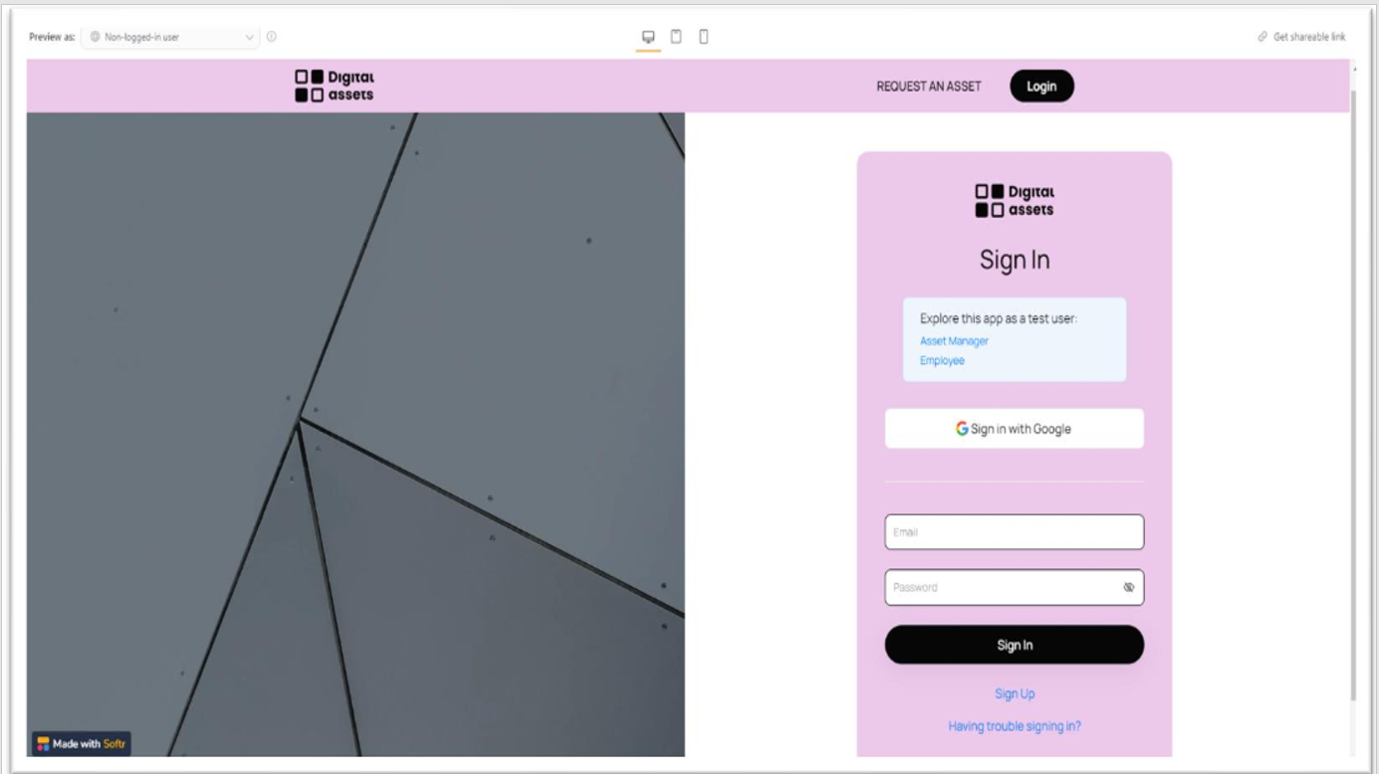
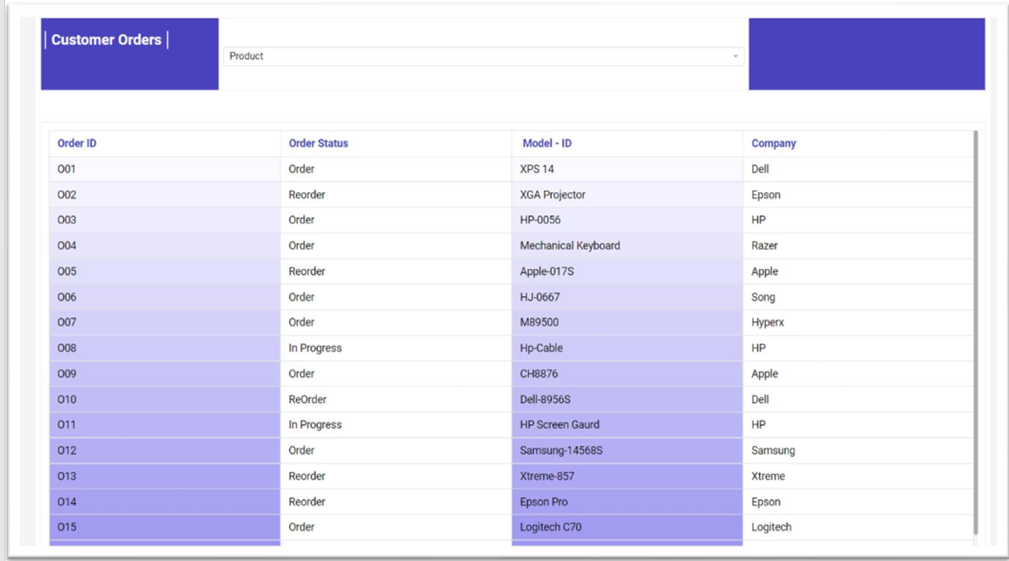
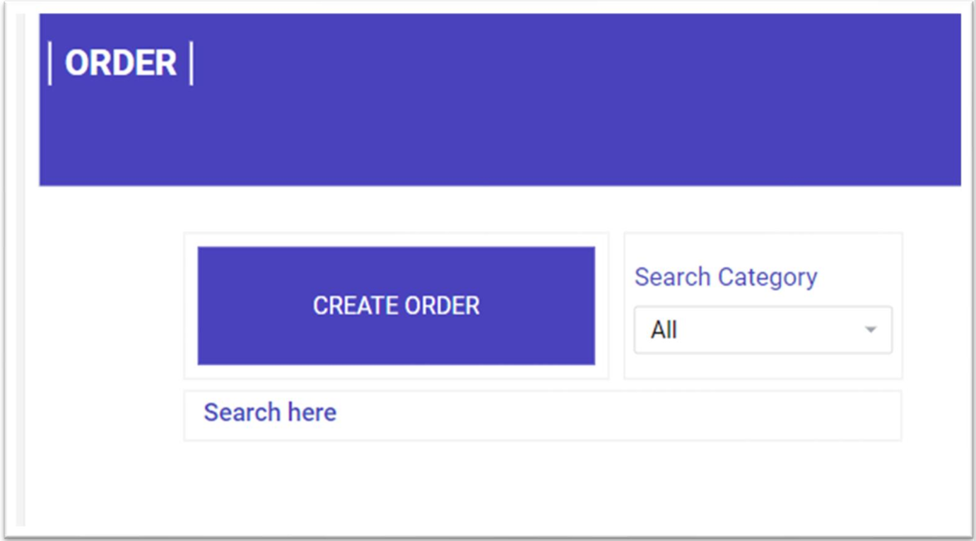
Narrated by Devendra Reddy

Slide 14
Infrastructure Architecture
Central server acts as core hub for storing crucial data and running the system.
Users connect to central server via devices like computers, laptops, tablets, or smartphones.
Internet connection enables access to cloud services and external communication.
Wireless access points (WAPs) provide Wi-Fi connectivity for flexibility and mobility.
Security measures, including firewall protection, ensure unauthorized access prevention, with integration tools facilitating secure data exchange and backup systems ensuring resilience.
Narrated by Devendra Reddy

Slide 15
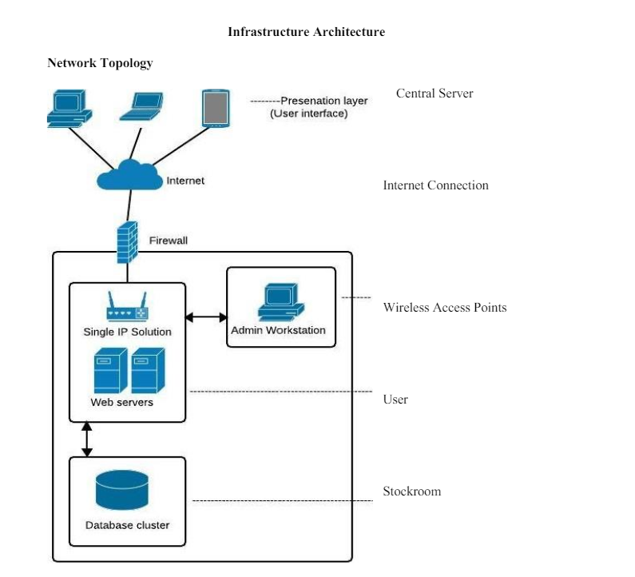
Narrated by Devendra Reddy

Slide 16
Security and Privacy Architecture:
Users must authenticate identity through strong passwords or other secure methods.
Two-factor authentication may be implemented for added security, requiring additional verification steps.
Session management ensures users stay authenticated throughout their session for continued security.
User passwords are encrypted to protect against unauthorized access to sensitive data.
Security measures aim to protect user information, prevent unauthorized access, and comply with security standards, enhancing user trust in the system's security measures.
Narrated by Devendra Reddy

Slide 17
References
Tilley, S. (2020). Systems Analysis and Design (12th ed.). Cengage.
Express Metrix (2009). Quantifying ROI: Building the business case for IT and software asset management. https://www.expressmetrix.com/pdf/ROI_6.pdf
Elise Williams. (2021, October 15). Top 5 IT Asset Management Software Open Source. https://pdf.wondershare.com/business/it-asset-managementopen-source.html Edwards, J., Ketchen, D., & Short, J. (2014). Mastering Strategic Management. BCcampus.

